Slide 1
Precision Optical Measurements Using Weak Values and Nonclassical States of Light
Kevin Lyons

Slide 2
Outline
Introduction to weak value amplification
Noise reduction with weak values
Enhancing weak value amplification with optical recycling
Squeezed states of light
Improving scaling with photon number using biphoton entanglement

Slide 3
Quantum Measurements
In a typical quantum measurement a system of interest is entangled with a pointer
The experimenter makes a direct (projective) measurement on the pointer
For measurements of a very small parameter, the final pointer state only differs from the initial by a perturbatively small term.
A motivating example: to determine the tilt of a mirror we shine a laser at it and measure the position. A small tilt yields a small shift.

Slide 4
Postselected measurements
Aharonov, Albert, and Vaidman (1988) proposed an intermediate step involving the system state.
“Preselection”: The system is prepared in some initial state (as usual)
“Postselection”: Before measuring the pointer, only probes in some given state are selected, the remainder are discarded
Surprisingly, for a judicious choice of pre and postselection states, they showed the average pointer variable can be made arbitrarily large.
This is weak value amplification

Slide 5
The AAV example – electron spins
Start with an electron beam polarized in the +x-direction (in an eigenstate of the Pauli X operator)
Induce a very small spin-dependent shift in the z-direction with a magnetic field
Postselect on the small fraction of –y polarized electrons with a strong magnetic field
The z-spin is the system and the beam position is the pointer
“How the Result of a Measurement of a Component of the Spin of a Spin-1/2 Particle Can Turn Out to be 100”

Slide 6
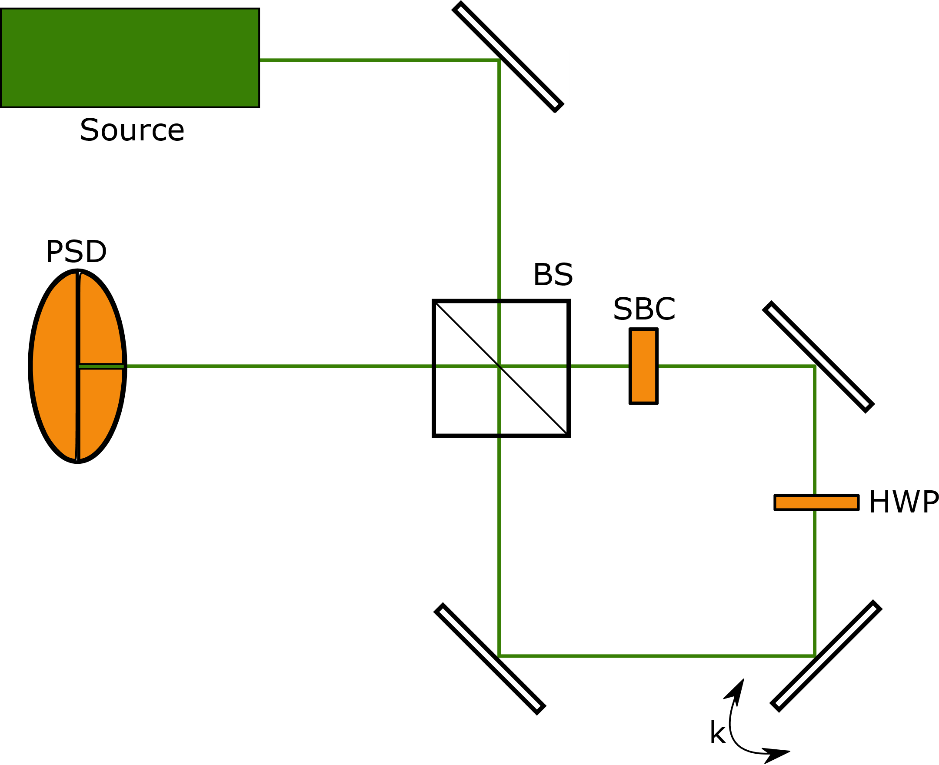
An optical equivalent – Rochester WVA setup
Dixon et al. (2009) (et al. includes Andrew & John) achieved record sensitivity with the following setup:

Slide 7
Rochester WVA setup continued
Exactly parallels the AAV experiment
Quickly extended to precision phase and frequency measurements
Matches or exceeds the precision of competing methods requiring more complicated experimental setups
At first glance, it is unclear why weak value amplification improves sensitivity at all – the amplification of the pointer variable should be exactly negated by the loss in photons to postselection

Slide 8
Technical noise
Weak value amplification allows for measurements which are robust to technical noise
This was noted first by experimentalists (e.g. the Kwiat group performed ultra-precise measurements on a non-floating table)
Theoretically we have demonstrated weak value amplification can overcome several types of technical noise in position, phase, and frequency measurements

Slide 9
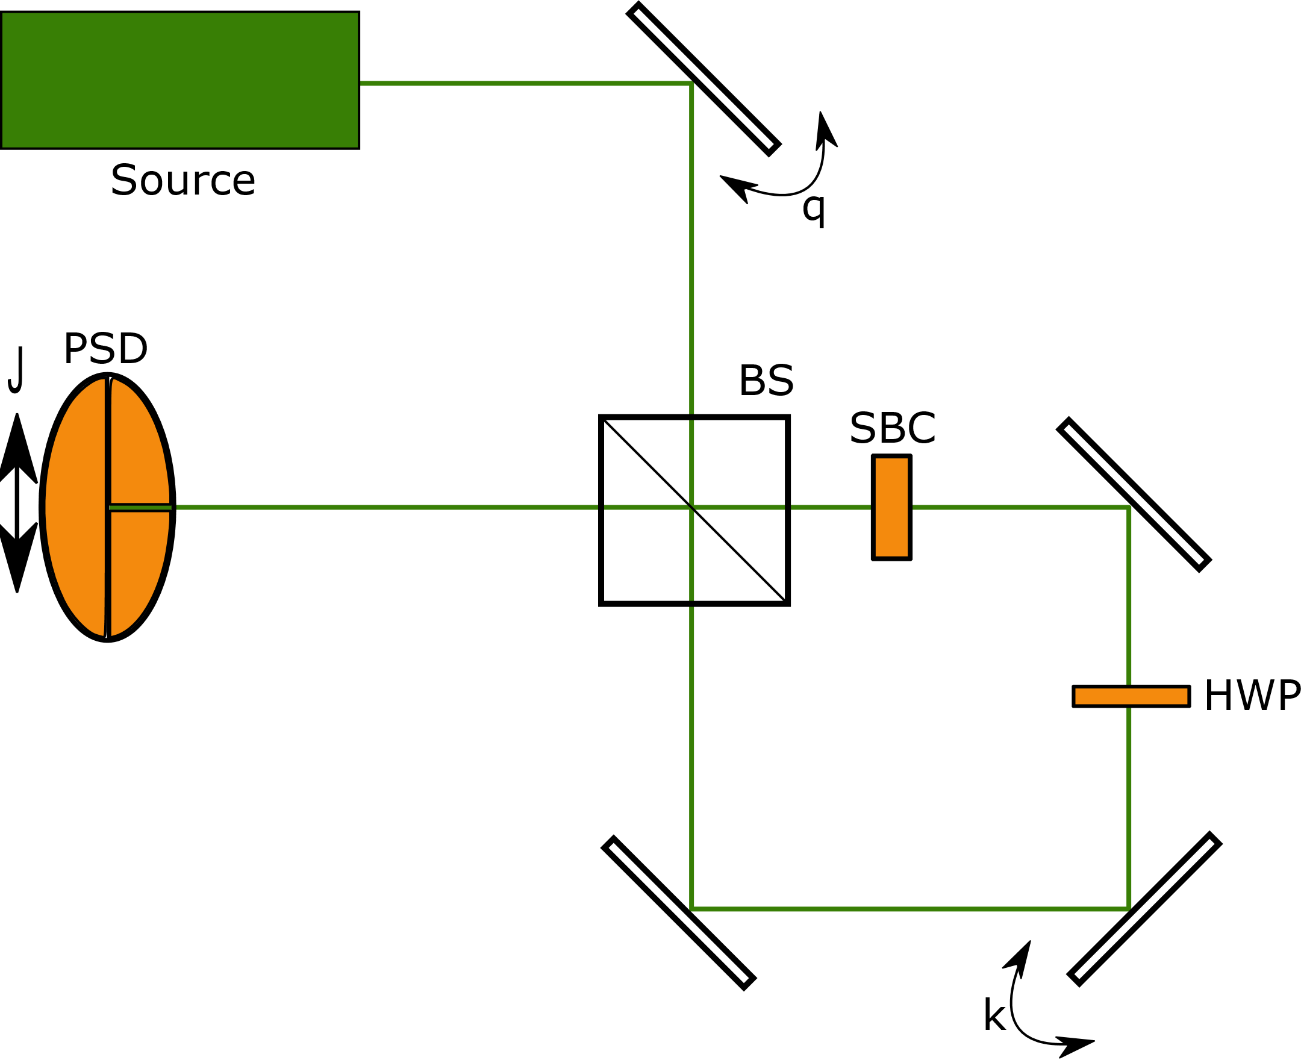
Technical noise continued
Robust to spatial beam/detector jitter, angular jitter, and time correlated noise

Slide 10
Single pass weak value summary
Weak value amplification allows us to capture all of the information (e.g. Fisher information) contained in direct measurement schemes with only a small fraction of events detected
The large pointer shift allows us to overcome certain types of technical noise
Non-postselected photons are discarded even though they must carry information about the parameter being measured
Only reduces the effect of technical noise, quantum uncertainty remains unchanged

Slide 11
Reusing non-postselected photons
Problem: postselection throws away potentially useful photons
Solution: Recycling!
Photons which don’t survive postselection can be sent back through the system for further attempts
We have considered two separate recycling schemes:
Pulsed recycling – uses a pulsed laser and precision electronics to contain the pulses
Continuous wave recycling – uses passive optics and interference to contain light in the system

Slide 12
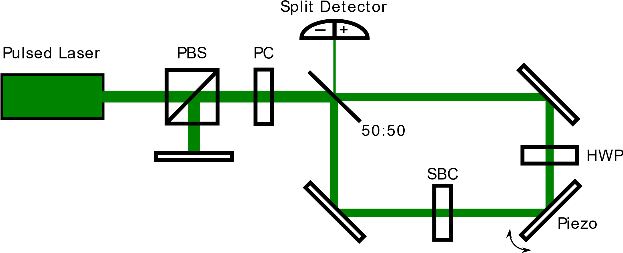
Pulsed recycling setup

Slide 13
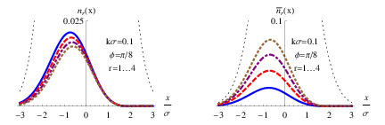
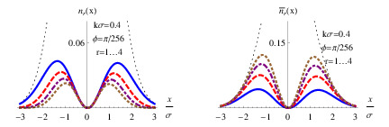
Pulsed recycling
On each pass, more of the beam is postselected and increases the net signal
On early passes, the beam profile is mostly unchanged by postselection so each pass contributes almost equally to the Fisher information
WV Regime IWV Regime

Slide 14
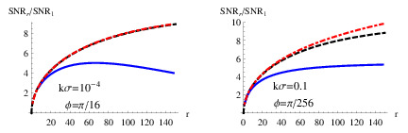
Beam degradation and SNR
After many postselections, the beam leaving and entering the bright port will not have a nice Gaussian shape
This degrades the measurement SNR
Can be fixed by flipping the beam about the optical axis on every traversal

Slide 15
Experimental considerations
This setup is fundamentally limited by the speed of the Pockels cell
No more than a few pulses (and likely only one pulse) can reasonably fit in the recycling system at once
Can be improved by increasing the length of the interferometer arms, but this makes the experiment more challenging to perform
Losses above a few percent quickly reduce the utility of recycling
More important that we expected!
Preliminary experiments show gains of a factor of less than 2 over the unrecycled case

Slide 16
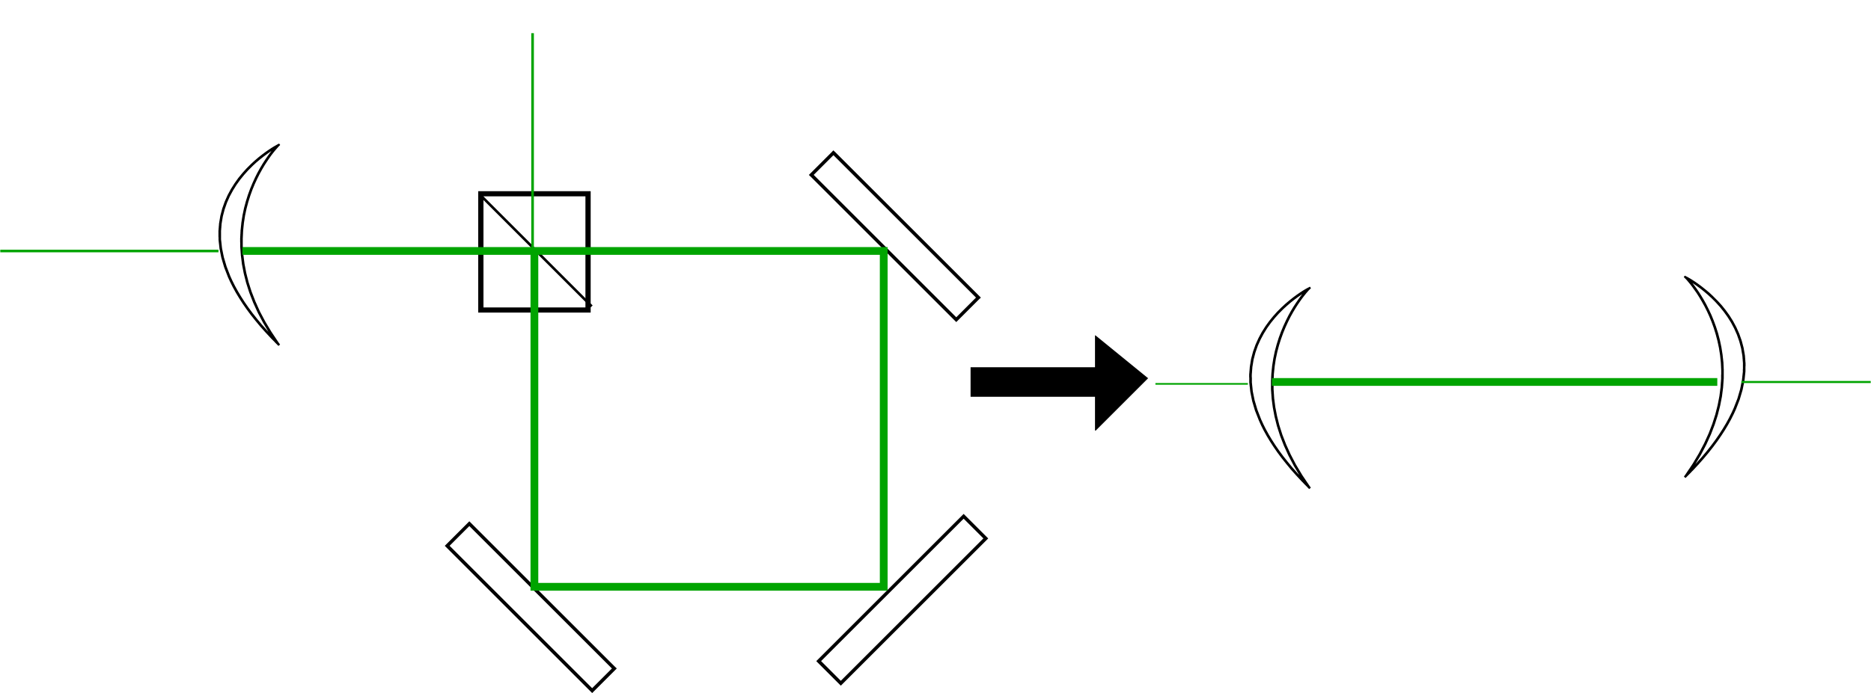
Continuous wave recycling
Drever (1983) showed that the power inside an interferometer could be dramatically increased by placing a partially transmitting mirror before the input port
Effectively places the interferometer in a cavity

Slide 17
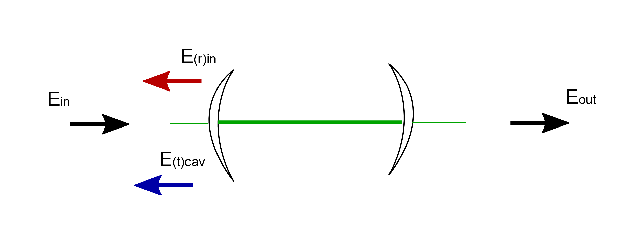
How CW recycling works
By appropriately setting the phase and recycling mirror transmittance, no light reflects back toward the laser source (destructive interference)
The intensity increases in the cavity until the power leaving the cavity is equal to the input laser power (constructive interference)

Slide 18
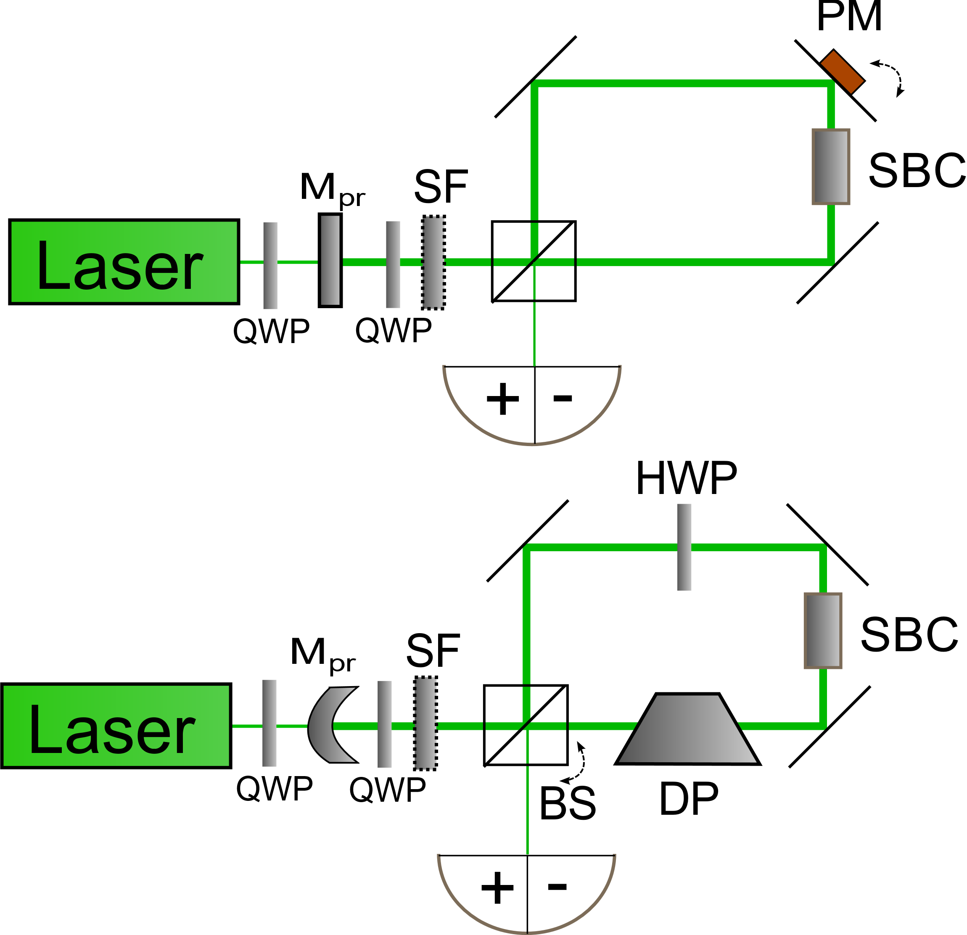
Recycling the Rochester WVA setup
The fraction of light leaving the dark port is set by the postselection probability
Choosing the mirror transmittance and location appropriately allows us (in principle) to detect 100% of the light

Slide 19
SNR gains from recycling
In a single pass WV measurement, the pointer magnitude is enhanced but the measurement statistics are reduced.
These effects cancel each other up to a factor of 1
With continuous wave recycling, there pointer amplification is the same (up to a factor), but there is no reduction in photons detected
In the absence of loss, the SNR gains from recycled WVA are essentially unbounded

Slide 20
Experimental results
This experiment was done by Wang et al. (2016)
They achieved a SNR enhancement of 2.40 compared to the single pass experiment
Also showed their signal to noise was below the shot-noise limit for single pass schemes
Nice result, but still the usefulness is limited by optical losses (~10% for stability purposes)

Slide 21
Other experimental considerations
In the regime of high laser power, large interferometers, low postselection probability, and low optical loss, additional concerns arise.
Photons which are only postselected after many traversals can travel very long distances. Coherence length becomes important.
The intensity in the interferometer grows as 1/postselection probability. At sufficiently high intensity, optics will be damaged
Note these issues have to do with recycling in general, not our particular weak value proposals

Slide 22
Recycling summary
Recycling can improve the sensitivity of measurements over non-recycled schemes
CW recycling is probably easiest to implement in a useful way
All passive optics, no precision timing electronics needed
Lends itself well to complementary techniques (e.g. squeezed states, signal recycling)
Both CW and pulsed schemes are significantly affected by optical losses, especially when they become larger than a few percent

Slide 23
Quantum uncertainty
So far we have confronted two different issues in precision metrology:
Technical noise – weak value amplification allows us to overcome this through an arbitrarily large pointer shift
Postselection helps with technical noise but also introduces the problem of poor statistics. Recycling can fix this.
Weak values and recycling can not improve the scaling with photon number because they can not reduce the effect of quantum uncertainty.
This requires nonclassical states of light

Slide 24
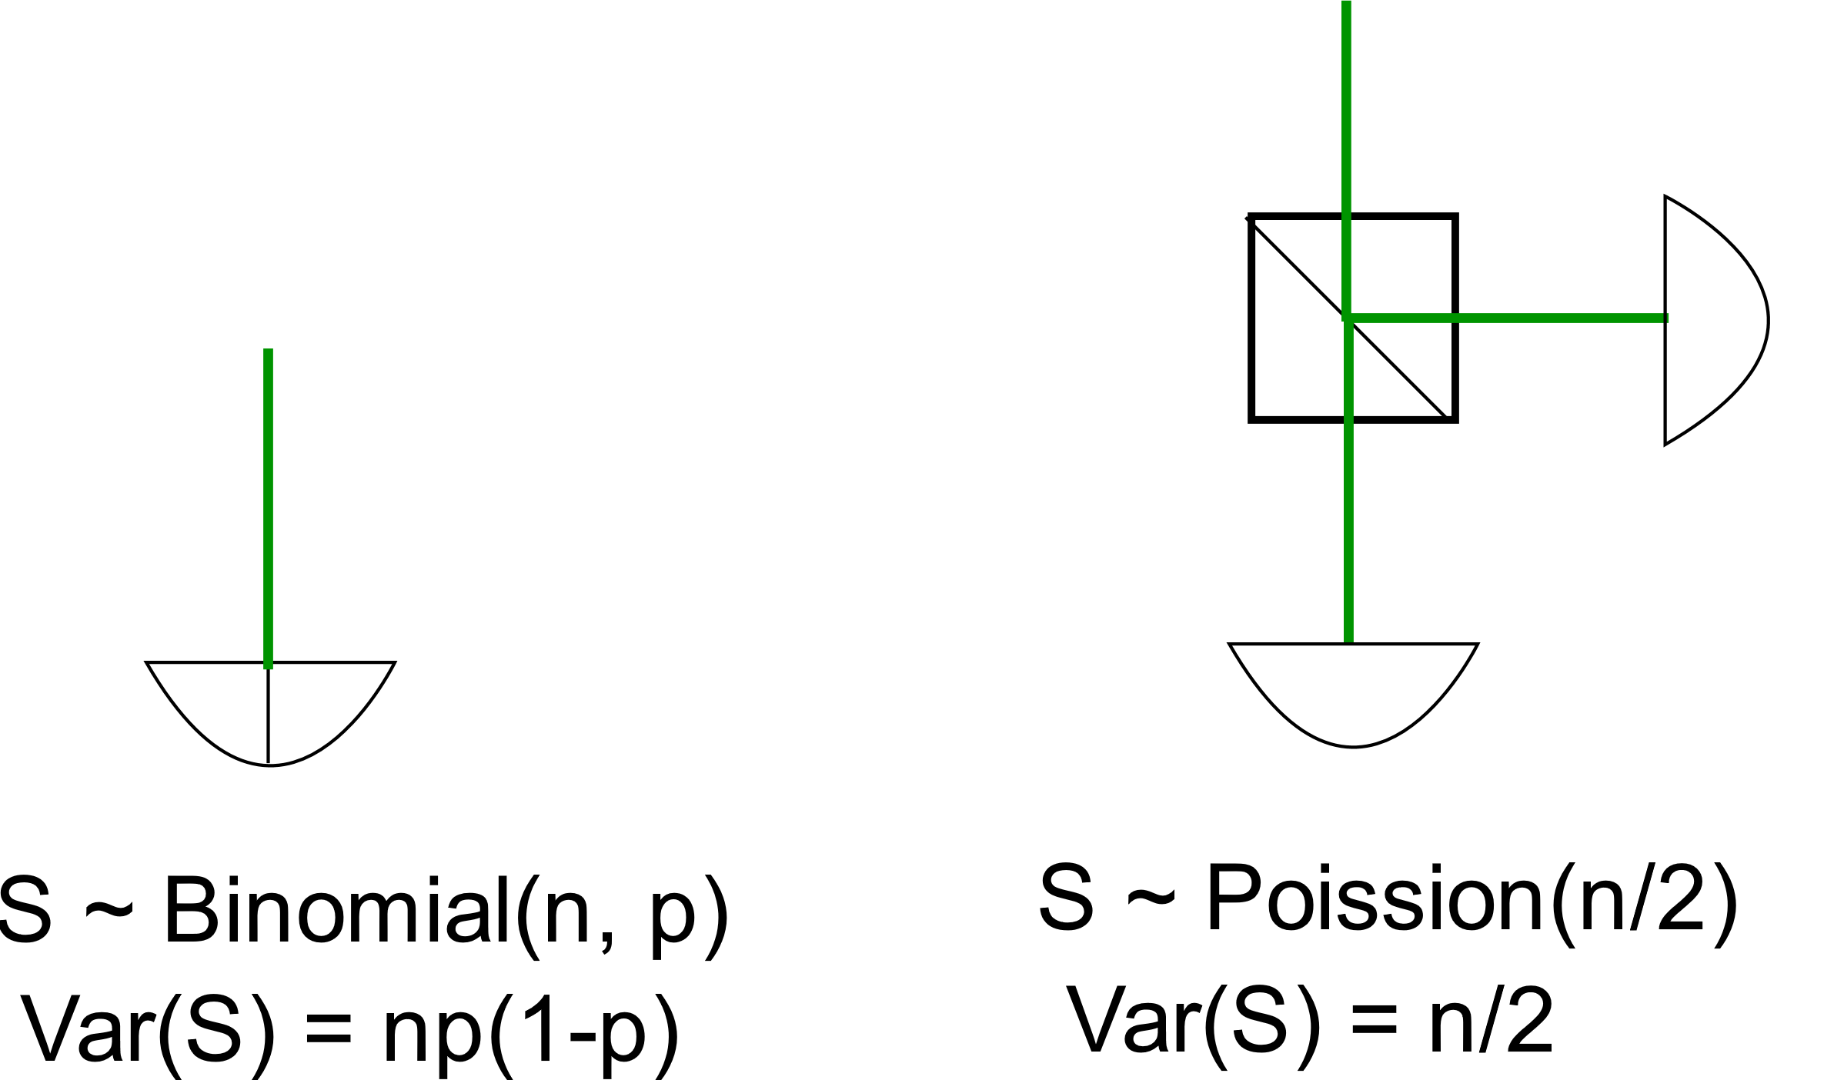
Statistics of classical measurements
Classical measurements typically scale as the square root of photons/probes/trials:

Slide 25
An example – N00N states

Slide 26
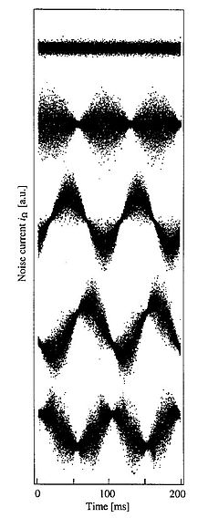
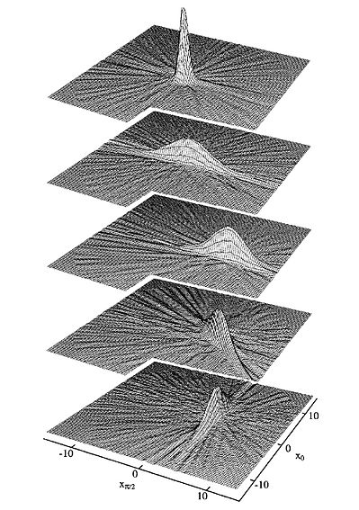
Squeezed states of light
Like the harmonic oscillator ground state and coherent states, squeezed states saturate the Heisenberg uncertainty limit.
Unlike those states, squeezed states allow one to adjust parameters such that the variance in one observable can be made arbitrarily low at the cost of increasing the variance in the conjugate observable
Credit: Gerd Breitenbach, Wikimedia

Slide 27
Squeezed states in experiments

Slide 28
Spatial modes of squeezed light

Slide 29
Squeezed weak value amplification

Slide 30
Squeezing + recycling + WVA?

Slide 31
Squeezed light summary

Slide 32
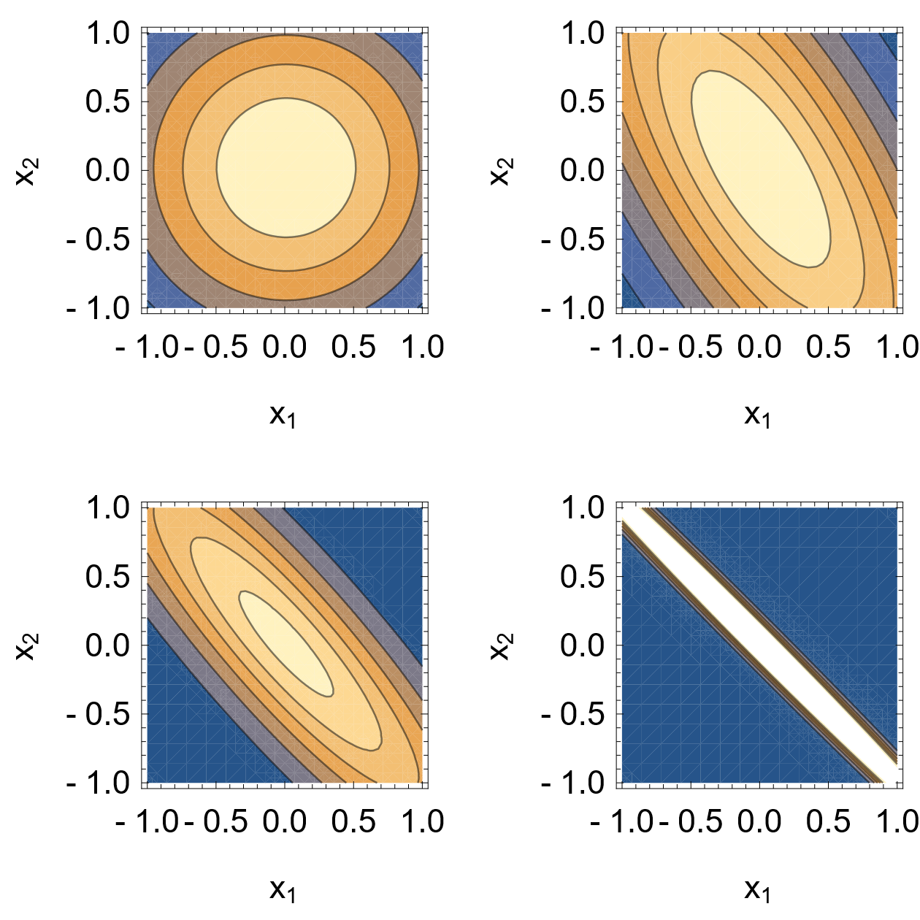
Entangled biphoton states
Created via spontaneous parametric downconversion (SPDC)
Even for a wide beam profile, the variance in the sum of positions of the individual photons can be made small

Slide 33
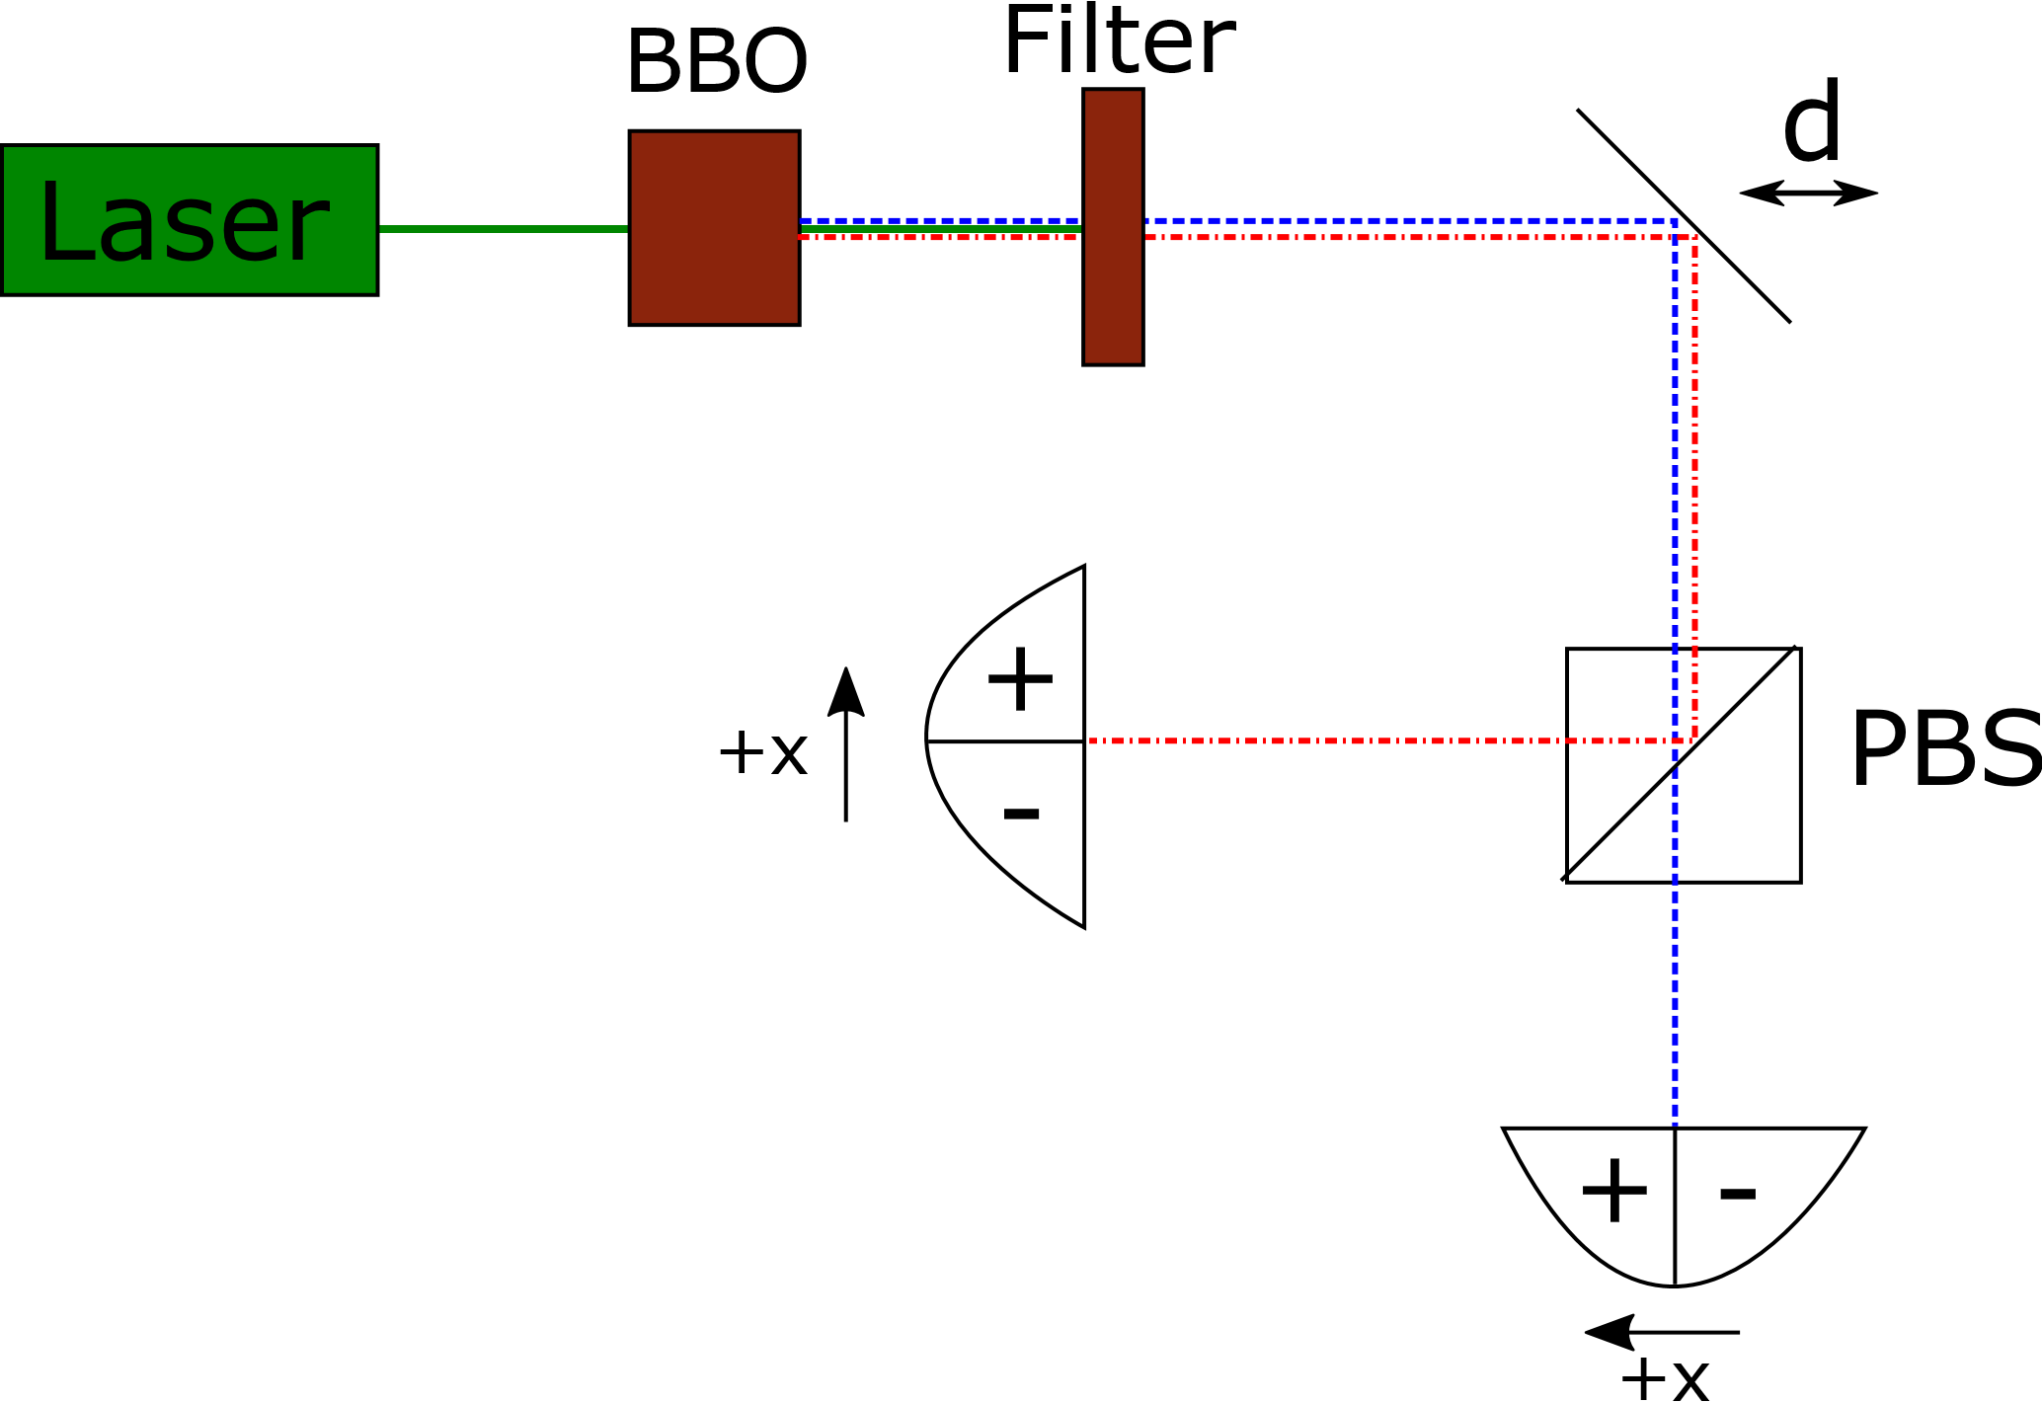
A biphoton displacement experiment

Slide 34
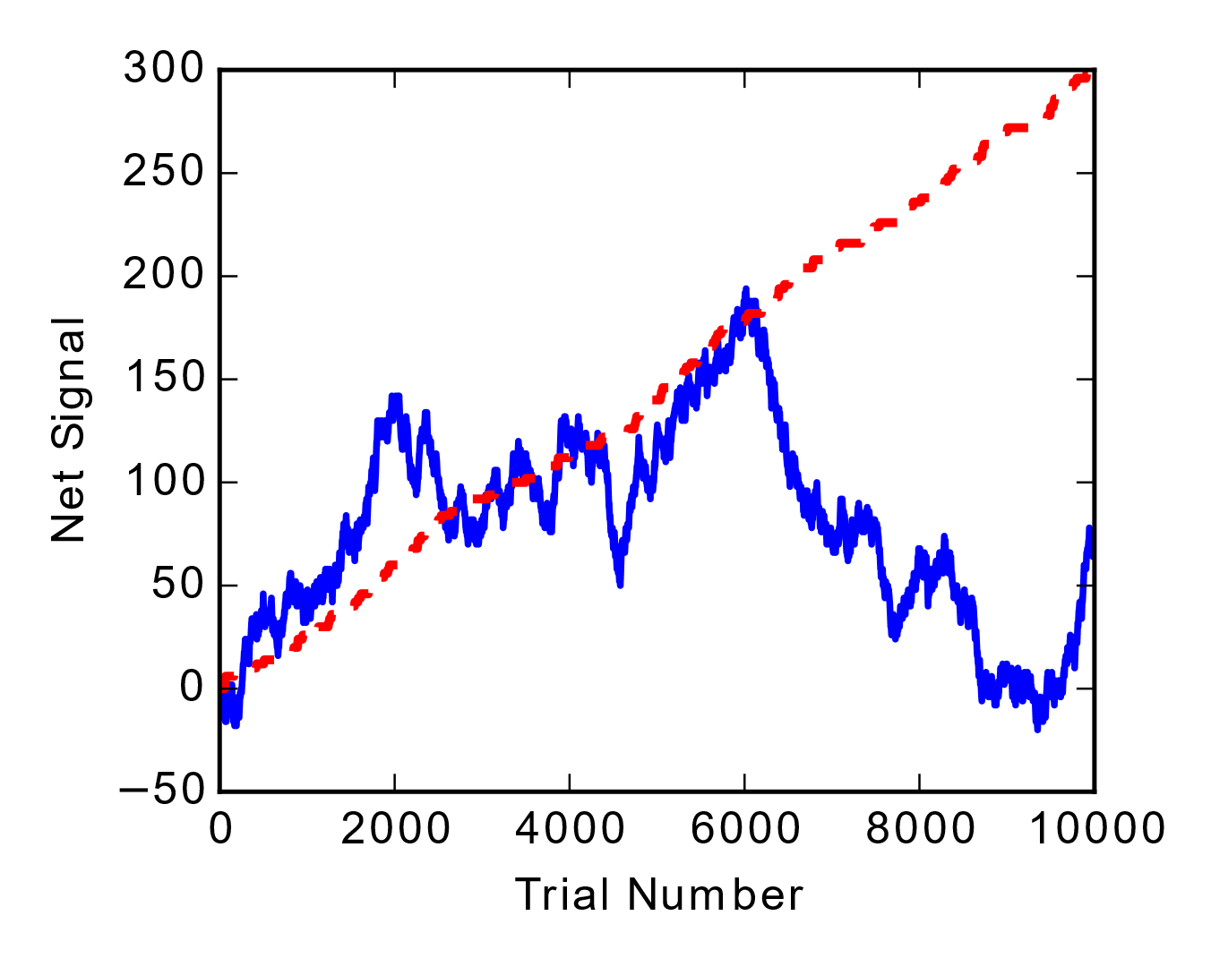
Why should biphotons improve sensitivity?
The positions of the biphotons are correlated at the detector.
The nature of the correlations ensures that the measurement is much more likely to yield no information about the shift or correctly indicate direction than incorrectly indicate direction

Slide 35
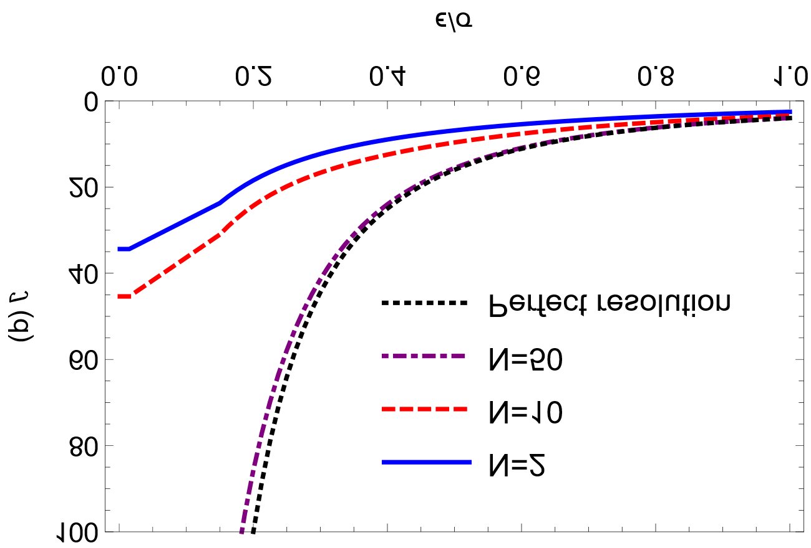
The effect of a pixelated detector
To actually realize the maximum possible Fisher information in the distribution, we would need a detector with perfect resolution
In the limit of a perfect detector and correlations, any displacement could be determined with one event
Fortunately, it is possible to obtain most of the benefit of a perfect resolution detector with a high resolution detector

Slide 36
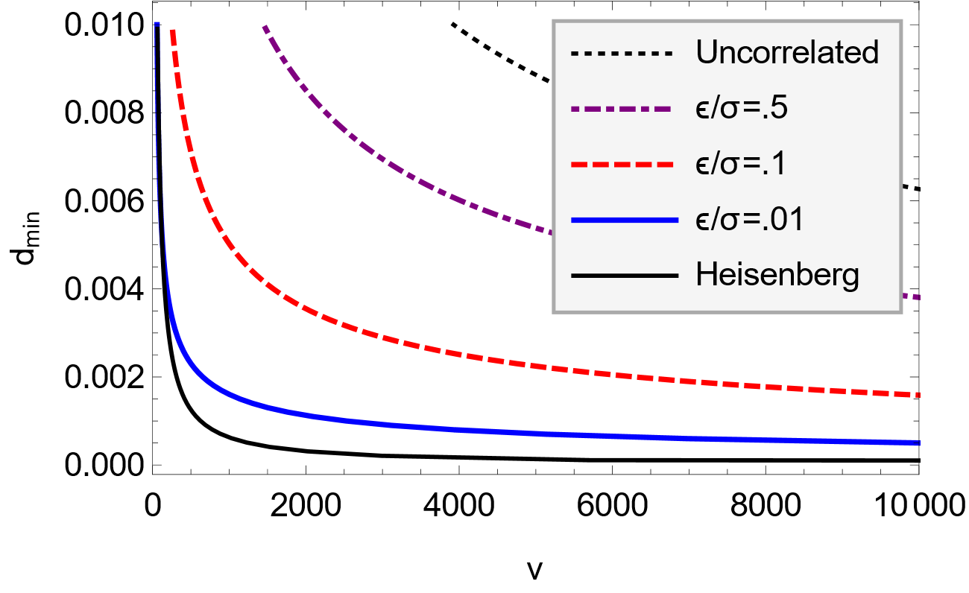
Scaling with independent events
A low resolution split detector will perform worse than a high resolution N-pixel detector for a given entanglement strength
However, if we compare a strongly entangled biphoton split detection experiment with an equivalent classical one, there can be a dramatic scaling improvement

